Slide 1
Welcome Delegates Slop Incineration Solutions from UTTAMENERGY

Slide 2
Brief Company Profile

Slide 3
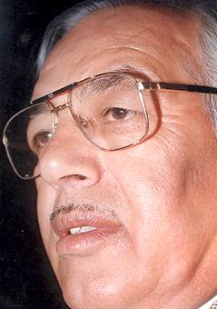
Our Vision
Uttam Chand Adlakha
Founder Chairman Uttam Group
“ To be a globally respected high-performance Organisation offering engineering products and services conforming to the tenets of Uttam Quality ”

Slide 4
Uttam Group Companies
Uttam Industrial
Uttam Sugar Mills
Uttam Biofuels
Uttam Centrifugals
Uttam School
Uttam Sucrotech
Uttamenergy

Slide 5
About Uttamenergy
Incorporated in the Year 2012 and located in Pune, India.
Inherited the legacy of LIPI Boilers,
LIPI Boilers founded by Mr. Kamal Mukherjee in the year 1974 after his 10 years stint at Foster Wheeler & Detroit stoker.
LIPI introduced Reciprocating grate and Travelling Grate concepts In India during oil crisis to promote Biomass/Coal.
Experience in biomass Boilers with 400+ Boilers burning 1000TPH Biomass to produce approx. 2500TPH steam.

Slide 6
Business Verticals
Turnkey Supplier for Boilers & Power Plants
Integrated Solutions for Sugar Plants
EPC Solutions for Distillery Units
O&M and RPMS Services for Sugar Plants, Distilleries and Power Plants
After Sales Services, Retrofit, Spares etc.
Contract Manufacturing

Slide 7
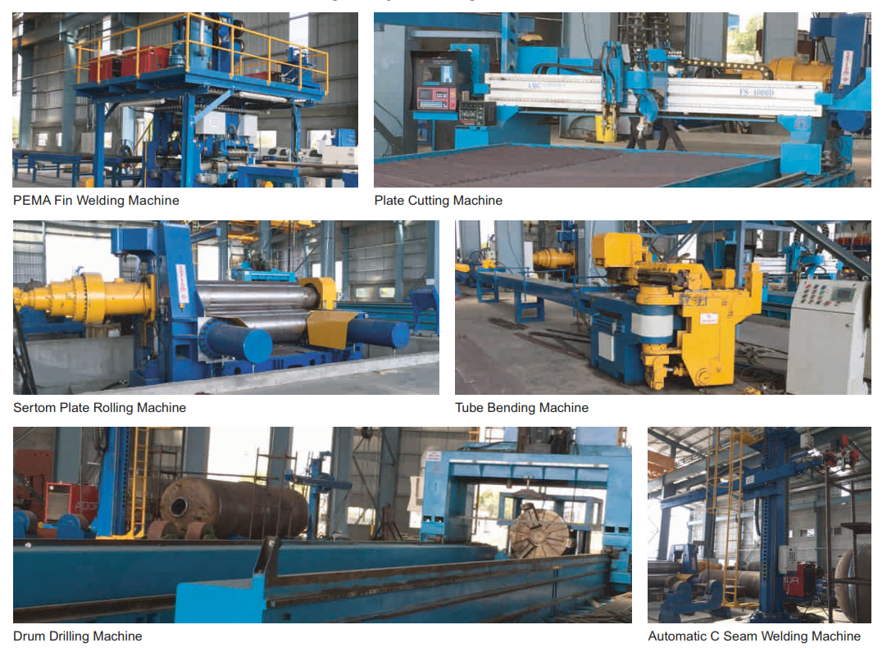



Manufacturing Facility

Slide 8
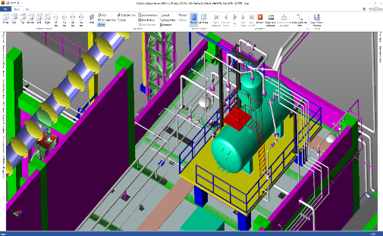
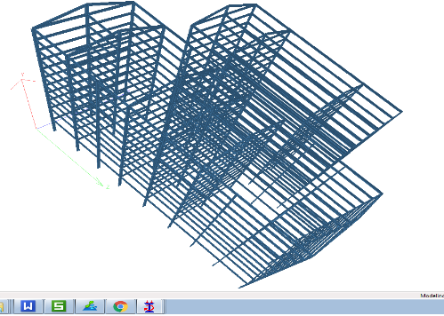
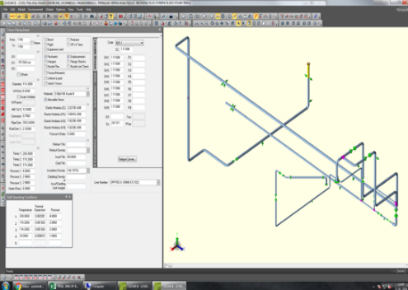
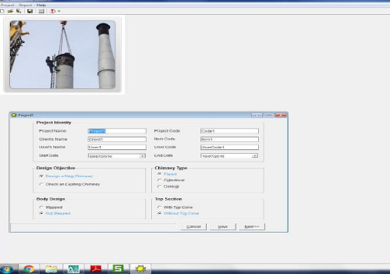
Engineering Softwares
CAD WORKS - 3D MODELLING
STAAD – STRESS ANALYSIS
CEASAR – STRESS ANALYSIS
CHIMNEY DESIGN

Slide 9
Slop Incineration Solutions

Slide 10
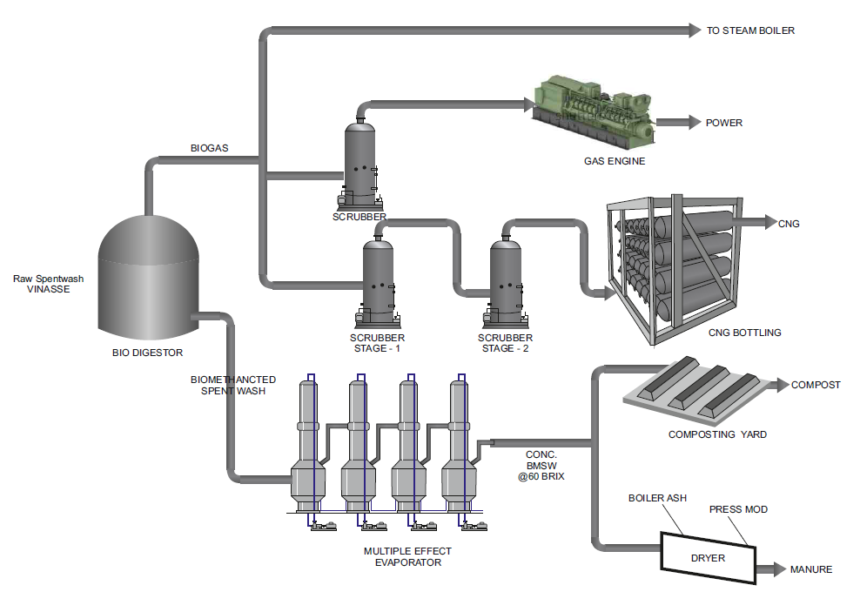
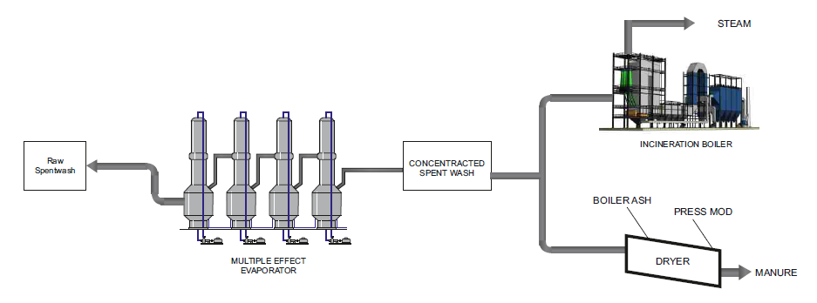
ZLD Solutions
1. Bio Composting Route 2. Slop Incineration Route

Slide 11
Challenges of Slop Incineration
Challenging Elements
High Chlorine content resulting in High temperature corrosion
High Sulphur content resulting in low temperature corrosion
High Potash content resulting in fouling of heat transfer surfaces
Implications on Boiler design
Superheat steam temperatures to be limited < 400 °C
Horizontal Boiler configuration to suit the fouling characteristics
Limitation of using APH (sulfur dew point corrosion) forcing to preheat the combustion air through steam coil air preheaters

Slide 12
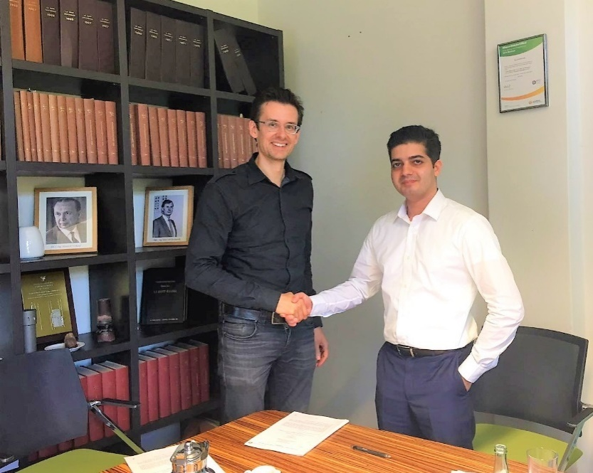

Technical Collaboration
ERK Eckrohrkessel GmbH, Germany
Licensee of ERK to provide Boiler solutions on wide
Variety of fuel including Corrosive Biomass & Municipal
Waste in Indian & abroad Market
About ERK
Expertise in Boiler design for more than 70 years with around 6000 references around the Globe
Patented multi pass designs for Corrosive Biomass and Municipal Waste

Slide 13
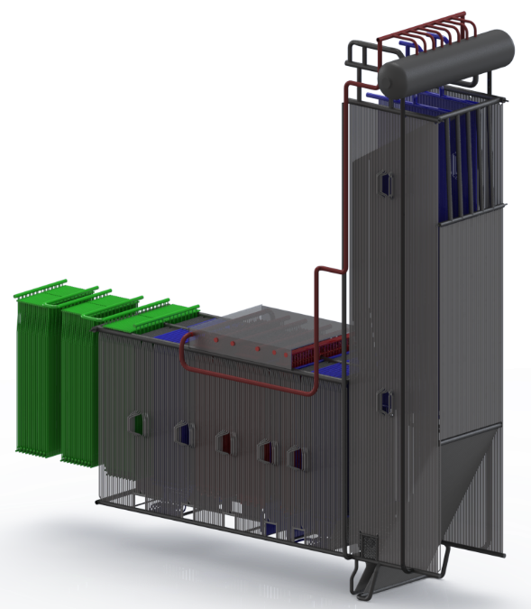
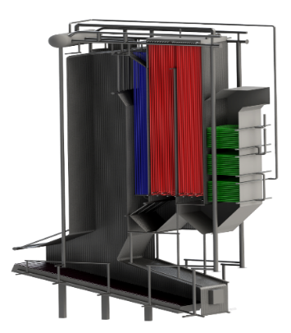
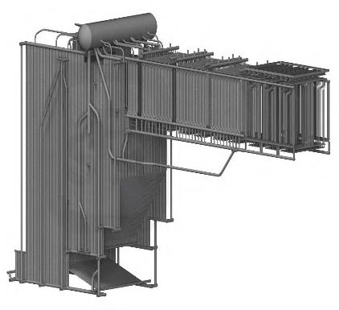
Incineration Boiler Configurations
Germany
Technology provider for specialized and proven boiler design on municipal and industrial waste. Both Vertical and horizontal design ensure boiler availability of 8000 Hours.

Slide 14
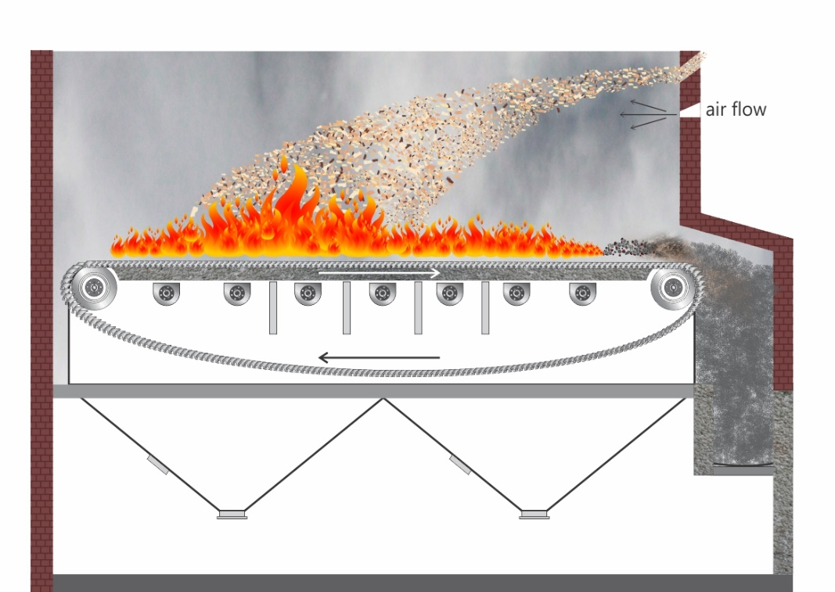
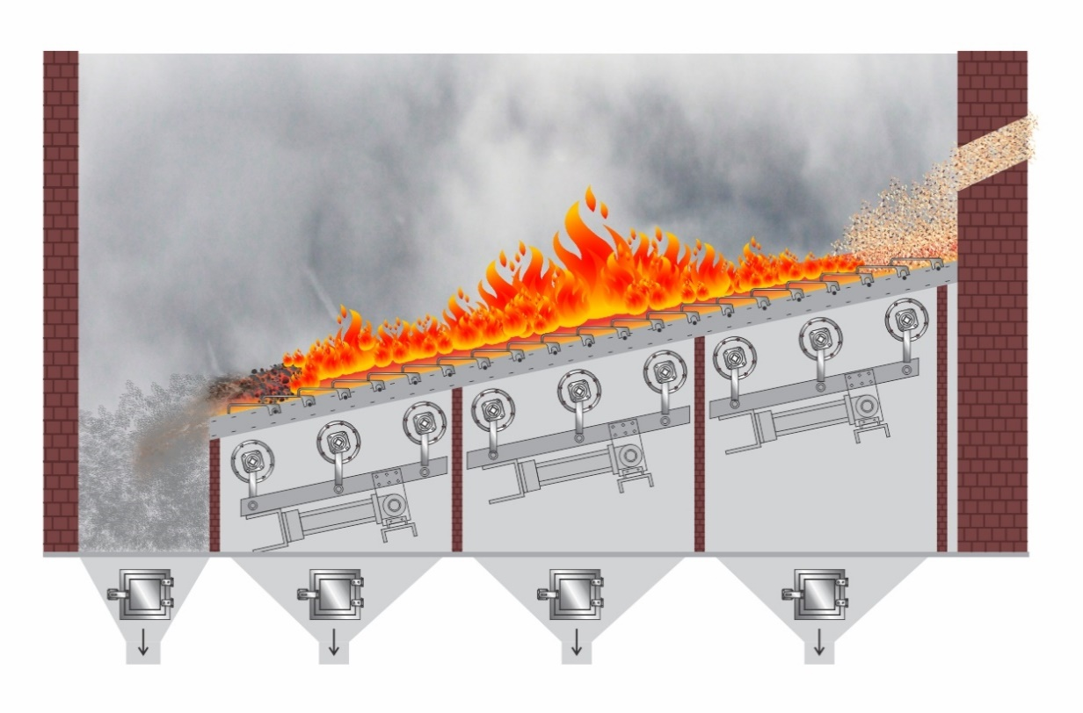
Combustor Options
Travelling Grate
Reciprocating Grate

Slide 15
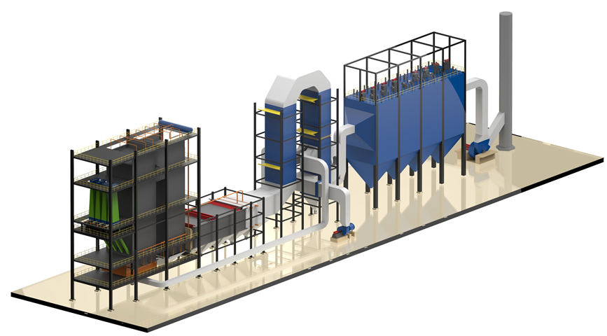
Steam Boiler General Arrangement

Slide 16
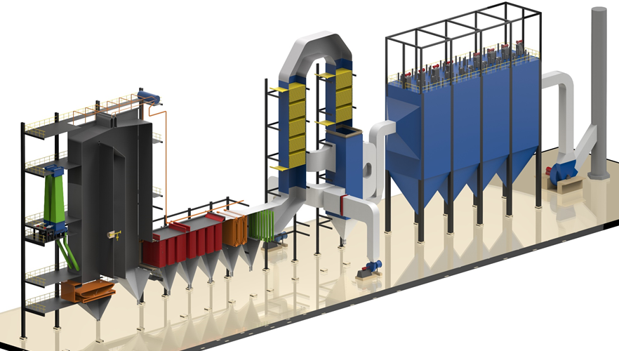
Steam Boiler (Cut section)

Slide 17
Fuel to Steam Balance
Slop @ 55brix
1 tph
Steam Boiler
Nett Steam qty to Steam Turbine
2.25tph @ 45kg/cm2g, 400 °C
Bagasse
0.38 tph @ 50% moisture

Slide 18
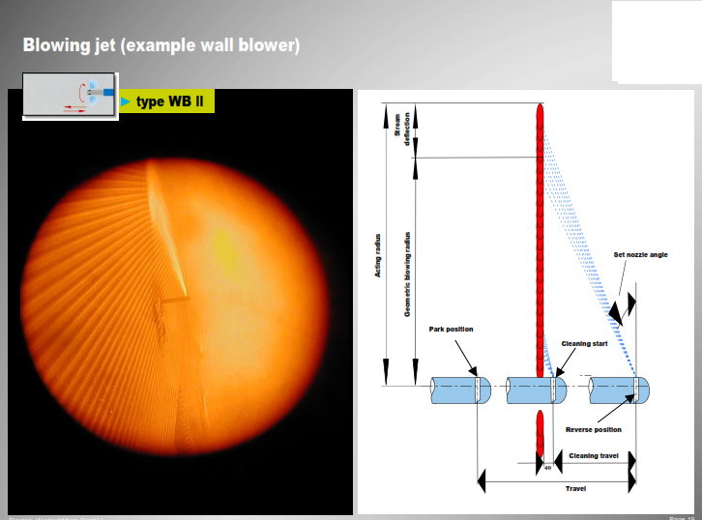
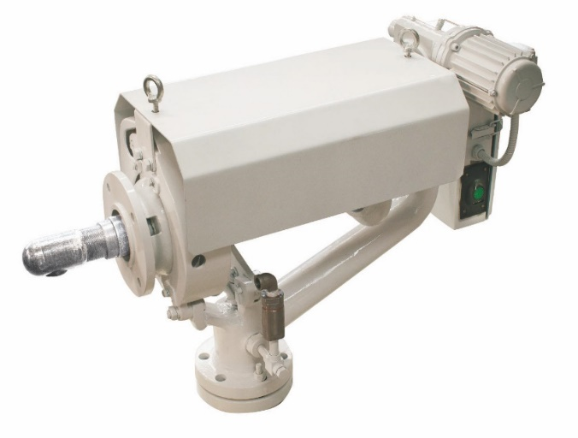
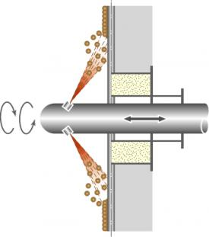
Wall Blowers on 1st & 2nd Passes
WALL BLOWER
AT OPERATION

Slide 19
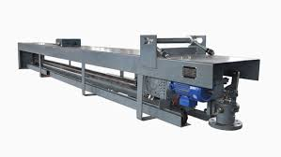
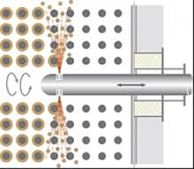
Soot Blowers on Heat Exchangers
RETRACTABLE TYPE
In Operation

Slide 20
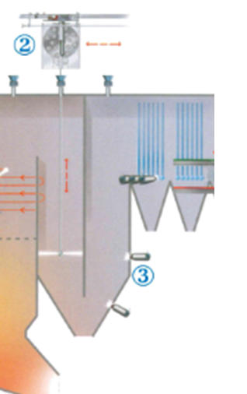
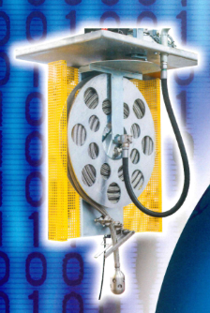
Water Spray type Soot Blower (Optional)
2. Spray Nozzle
IN OPERATION

Slide 21
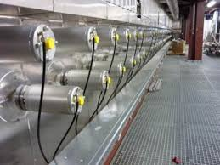
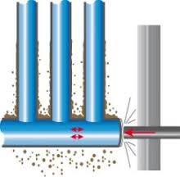
Rapping Type Ash removal (Optional)
RAPPERS
IN OPERATION

Slide 22
Summary
With ERK technical know how on Incineration boiler & LIPI’s proven Reciprocating / Travelling grate, Uttamenergy can provide SLOP incineration solution with,
Guaranteed Boiler availability of 150 days (cleaning cycle max. 3 days)
Less maintenance
Lower operating cost

Slide 23
Recent Distillery Projects
Commissioned Expansion project from 75 KLPD to 150 KLPD @ Uttam Distillery, Barkatpur
Under Execution – Modernisation & ZLD project @The Kisan Sahakari Chini Mills, Kaimganj
Under Execution – Modernisation & ZLD project @The Kisan Sahakari Chini Mills, Ghosi
Awarded Turnkey project for 45 KLPD Distillery @ The Panipat Coop Sugar Mills, Panipat
Under execution project for 50 KLPD distillery @ Uttam Distillery, Libberheri
Under execution project for 40 KLPD Grain Based Distillery @ Uttam Distillery, Haridwar

Slide 24
Thank you

